Slide 1



BLUELIME
MANAGEMENT
PORTAL
Created by:
Shwetark Deshpande
Tarun Lodha
Kedar Deshpande
Sanjana Chaudhari
Shivkumar More

Slide 2


OUTLINE
Problem Statement
Objective
Architecture
Project Flow
Technology and Tools Used
Challenges and Learnings
Conclusion
Project Overview

Slide 3
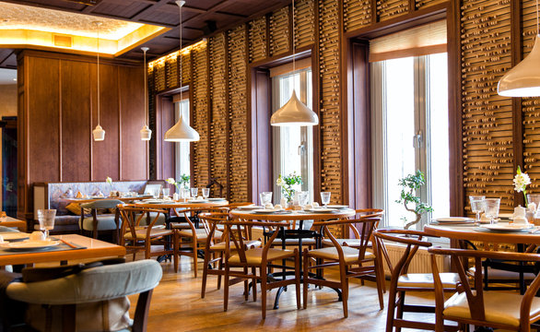
PROBLEM STATMENT
Our restaurant management hub project has made significant strides in providing essential functionalities for restaurant administration, customer
interactions, and order management.

Slide 4

OBJECTIVE
Project will result in an optimized and feature-rich restaurant management that empowers restaurant owners to efficiently manage their operations and enhances the dining experience for customers through improved user interfaces.​
​

Slide 5
PROJECT OVERVIEW
Project contains UI/UX for intuitive navigation and smoother workflows.
The project's foundation, which includes functionalities such as table booking, online menu selection, order processing, and customer management, has set the stage for a comprehensive platform.

Slide 6





ARCHITECTURE
Client
Server
Business Layer
Data Layer
Web browser
http request
Application server
Web server
File system
External API
Html page
Mobile browser
Json server

Slide 7
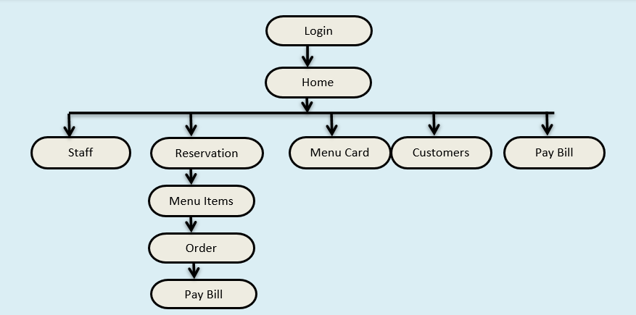
PROJECT FLOW
Login
Home
Staff
Reservation
Menu Card
Customers
Pay Bill
Menu Items
Order
Pay Bill

Slide 8








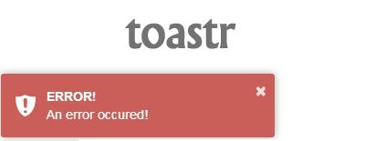

TECHNOLOGIES AND TOOLS USED

Slide 9

CHALLENGES AND LEARNINGS​
LEARNINGS
1. Architecture Design
2. APIs for Data Retrieval
3. Error Handling and Testing
4. User Experience (UX) Design
CHALLENGES
1. Understanding the System's Needs
2. Seamless Data Management
3. Real-Time Order Updates
4. Safeguarding Data Consistency

Slide 10

CONCLUSION
In conclusion, the development of a Restaurant Management System has been an enriching journey that has addressed a multitude of challenges and complexities.​
We were able to design a system that works efficiently and has desired functionalities​

Slide 11

THANK YOU!

